Slide 1


Title: PlanIt Smart Task Management
Student Name: Ritvik Reddy Bhavanam
Cluster: 3
Section: 11

Slide 2
ABSTRACT
IN THE DIGITAL AGE, EFFECTIVE TASK MANAGEMENT IS CRUCIAL FOR PERSONAL PRODUCTIVITY AND PROFESSIONAL SUCCESS. PLANIT ADDRESSES THE GROWING NEED FOR A SMART, INTUITIVE TO-DO MANAGEMENT SYSTEM THAT ADAPTS TO MODERN WORKFLOWS AND USER PREFERENCES.
THIS SYSTEM COMBINES ADVANCED WEB TECHNOLOGIES WITH USER-CENTRIC DESIGN PRINCIPLES TO DELIVER A SEAMLESS TASK MANAGEMENT EXPERIENCE. BY INTEGRATING SMART PRIORITIZATION ALGORITHMS, DEADLINE TRACKING, AND PROGRESS ANALYTICS, PLANIT EMPOWERS USERS TO STAY ORGANIZED AND ACHIEVE THEIR GOALS EFFICIENTLY.

Slide 3
ABSTRACT
THE PLATFORM FEATURES A CLEAN, DISTRACTION-FREE INTERFACE THAT PROMOTES FOCUS WHILE PROVIDING POWERFUL TOOLS FOR COLLABORATION AND PRODUCTIVITY TRACKING. WHETHER MANAGING DAILY TASKS OR COMPLEX PROJECT WORKFLOWS, PLANIT SERVES AS A COMPREHENSIVE SOLUTION FOR DIGITAL TASK ORGANIZATION.

Slide 4
EXSISTING SYSTEM
The existing task management methods are mostly manual or basic digital lists that do not efficiently organize tasks. Users often maintain tasks using simple notes, spreadsheets, or basic applications that lack structured data handling. These systems do not support efficient searching, priority-based organization, or undo functionality. As a result, managing large numbers of tasks becomes difficult, time-consuming, and prone to errors.

Slide 5
PROPOSED SYSTEM
The proposed system is a Java console-based Task Management Application that efficiently manages tasks using different data structures. Tasks are stored using a Linked List, allowing dynamic task management. A Stack is used to implement an undo delete feature, enabling users to restore removed tasks. A Max Heap is used to display tasks based on priority in descending order, ensuring that important tasks are handled first. The system also supports task searching, sorting, overdue task detection, and task completion updates, making task management more organized, efficient, and user-friendly.

Slide 6
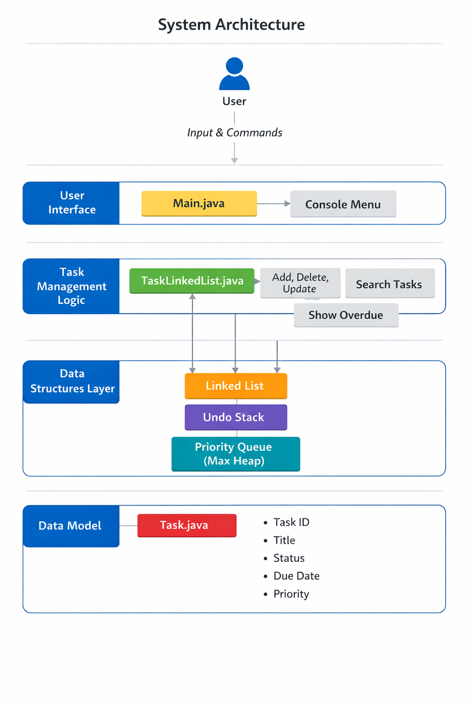
SYSTEM ARCHITECTURE

Slide 7
PROJECT MODULES
User Interface Module – Handles user input and menu operations.
Task Management Module – Performs task operations using Linked List.
Priority Management Module – Organizes tasks using Max Heap.
Undo Operation Module – Restores deleted tasks using Stack.
Task Data Module – Stores task attributes using the Task class.

Slide 8
OBJECTIVES
To design a task management system for organizing tasks.
To implement various data structures like arrays, stacks, queues, heaps, and hashing.
To manage and display tasks based on priority.
To improve searching and retrieval of tasks.
To demonstrate real-world applications of data structures.

Slide 9
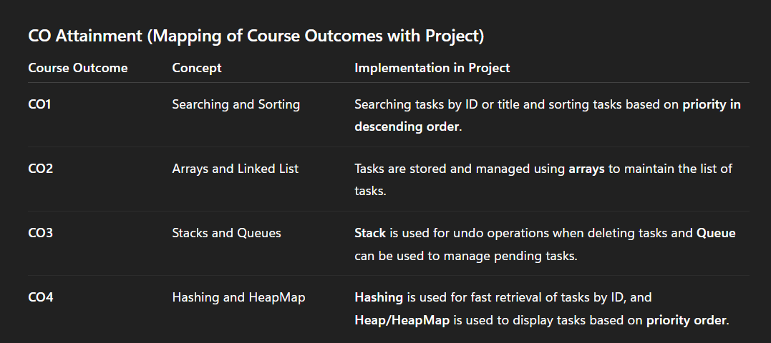
CO’S ATTAINMENT - DSA

Slide 10
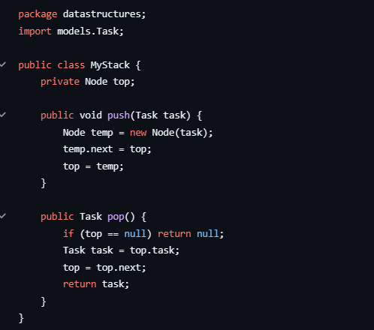
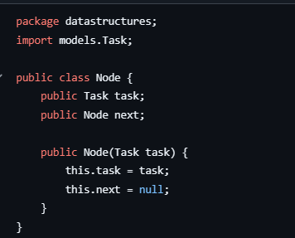
SCREENSHOT’S

Slide 11
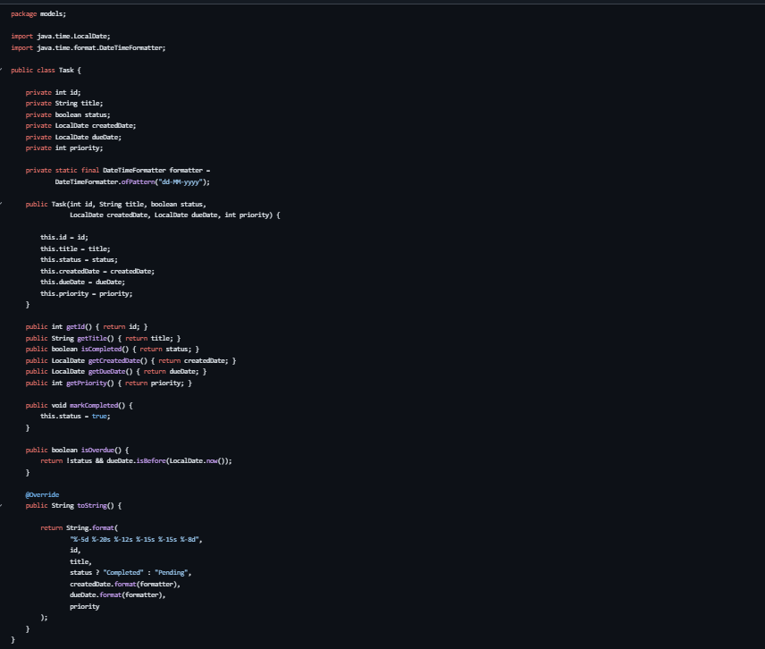
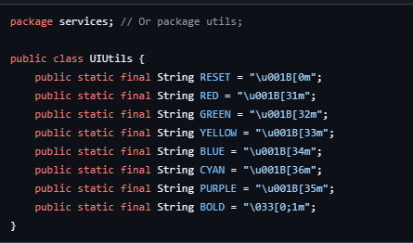
SCREENSHOT’S

Slide 12
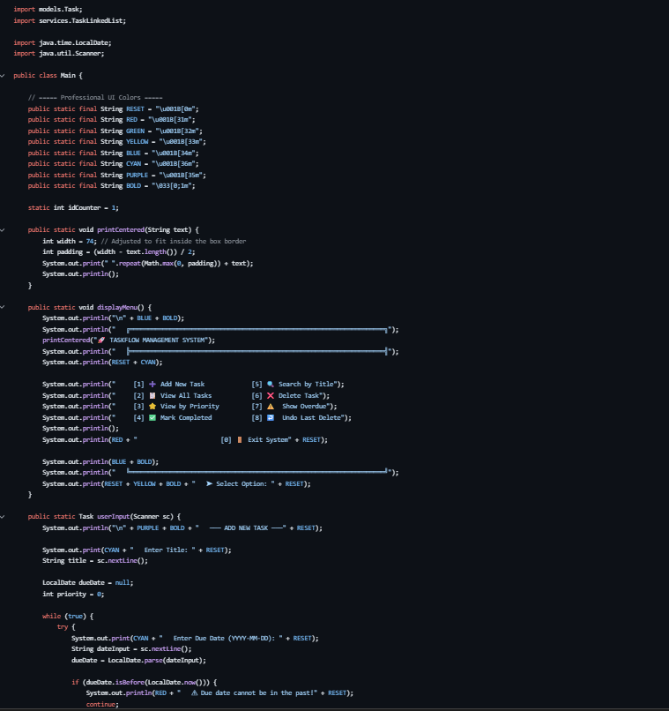
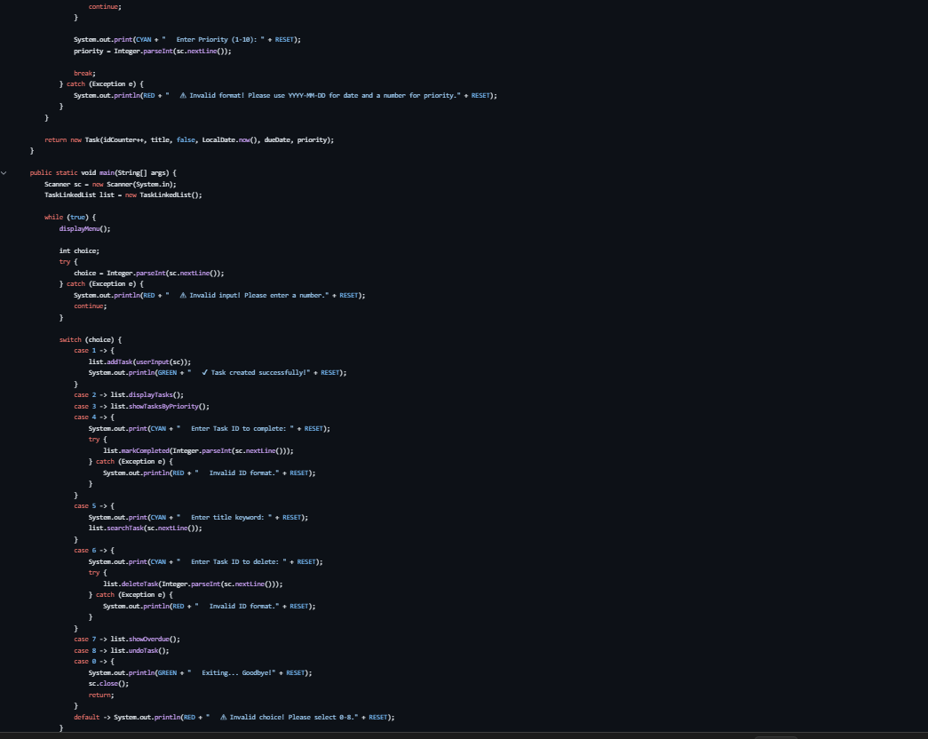
SCREENSHOT’S

Slide 13
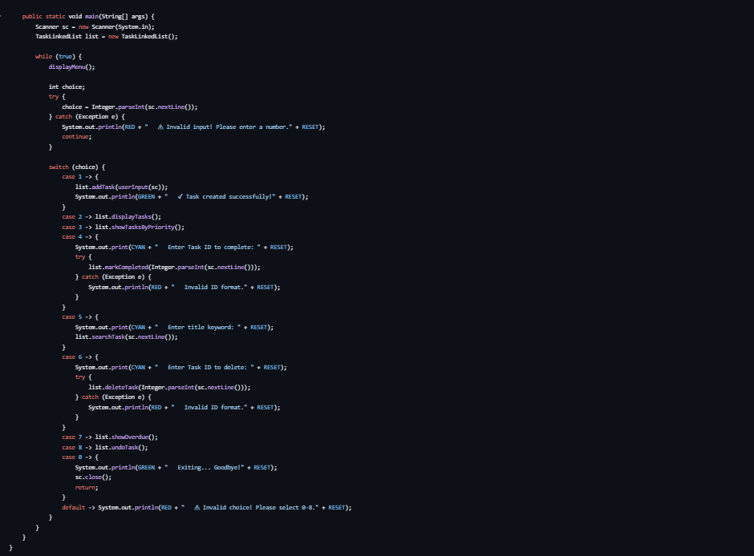
SCREENSHOT’S

Slide 14
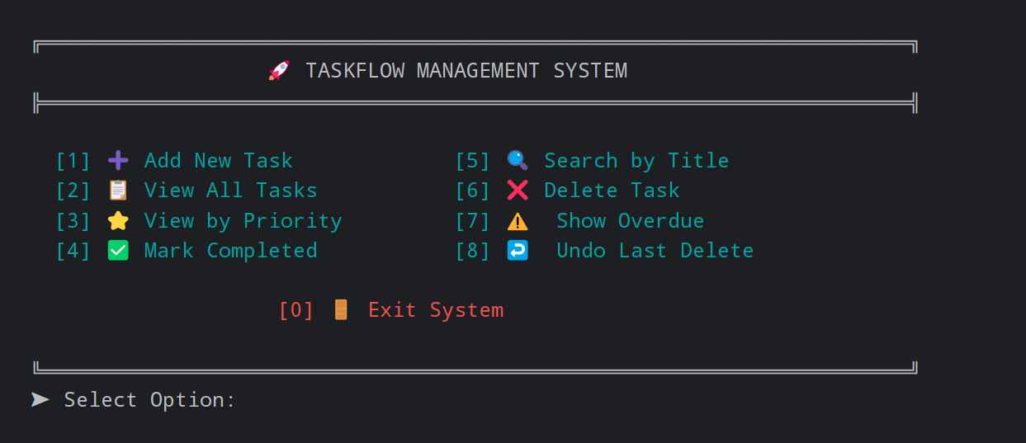
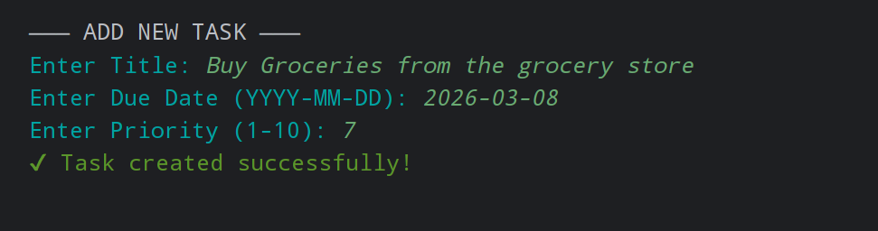
SCREENSHOT’S

Slide 15
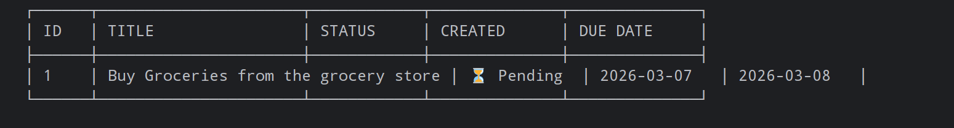
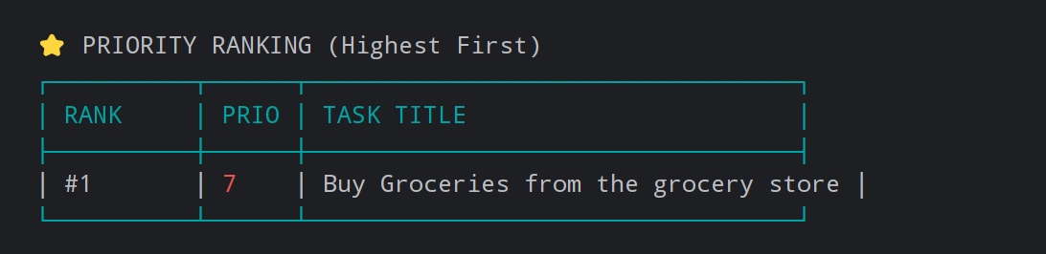
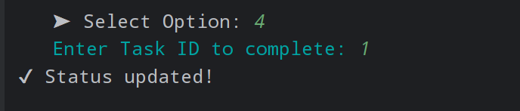
SCREENSHOT’S

Slide 16
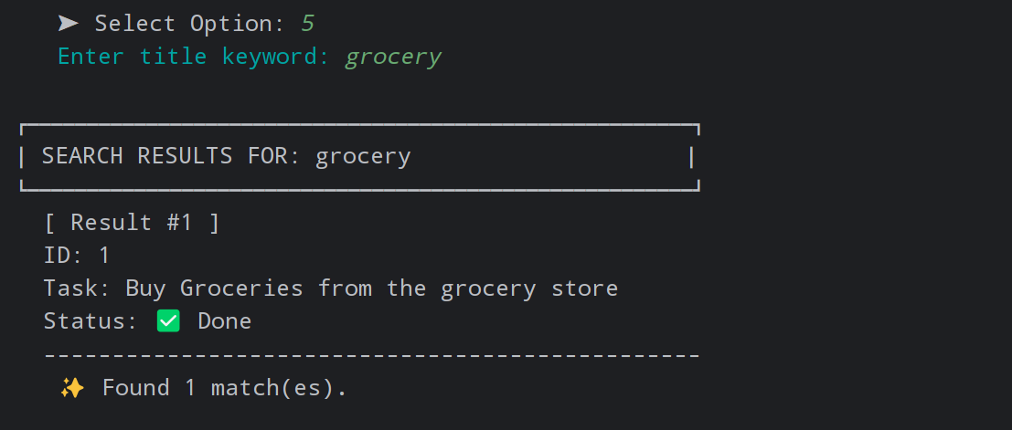
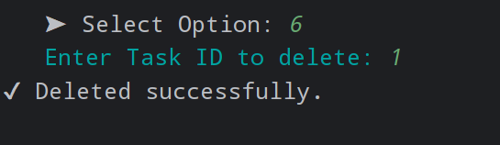
SCREENSHOT’S

Slide 17
CONCLUSION
The Task Management System was successfully developed to organize and manage tasks efficiently using various data structures. The system allows users to create tasks, set priorities, track due dates, and mark tasks as completed. By implementing concepts such as arrays, stacks, queues, searching, and heaps, the project demonstrates how data structures can be applied to solve real-world problems. The use of a Max Heap helps in prioritizing tasks so that the most important tasks are handled first. Overall, the project improves task organization, efficiency, and understanding of data structure concepts through practical implementation.

